Slide 1

AI-Powered Water Quality Prediction Dashboard Machine Learning + MySQL + Tableau Analytics
Submitted in partial fulfillment of the requirements for the award of the degree of
Master of Computer Applications (MCA)
By
Student Name: Danish Pinjari
Enrollment No: O24MCA112047
Under the guidance of
Guide/Mentor Name: Ms. Vasanthi Chandran

Slide 2
Certificate
Certificate from Qollabb to be attached
Project completed under mentor guidance
Institutional verification required

Slide 3
Declaration
I, Danish Pinjari hereby solemnly declare that the project report titled “AI-Powered Water Quality Prediction Dashboard” submitted in partial fulfillment of the requirements for the award of the degree of Master of Computer Application (MCA) is my original work.
I further declare that:
This project has been carried out by me during the academic year 2025-26 under the supervision of Ms. Vasanthi Chandran (Guide/Mentor Name).
The work has not been submitted previously to any other university, institution, or examination body for the award of any degree, diploma, or certification.
All sources of information used in this report have been duly acknowledged and referenced in accordance with academic ethics and plagiarism norms.
The data presented in this report is authentic to the best of my knowledge and has not been fabricated or manipulated.
I understand that if any part of this declaration is found to be false, my project may be rejected and disciplinary action may be taken as per institutional rules.
Place: Mira Road East Date: 20/05/2026
Student Signature: Danish Student Name: Danish Pinjari Enrollment No: O24MCA112047

Slide 4
Acknowledgement
Sincere gratitude to Ms. Vasanthi Chandran for guidance and support.
Thanks to Chandigarh University and CU Online for academic resources.
Appreciation to faculty members for continuous encouragement.
Special thanks to Qollabb for mentorship and project assistance.
Gratitude to family and friends for motivation and support.

Slide 5
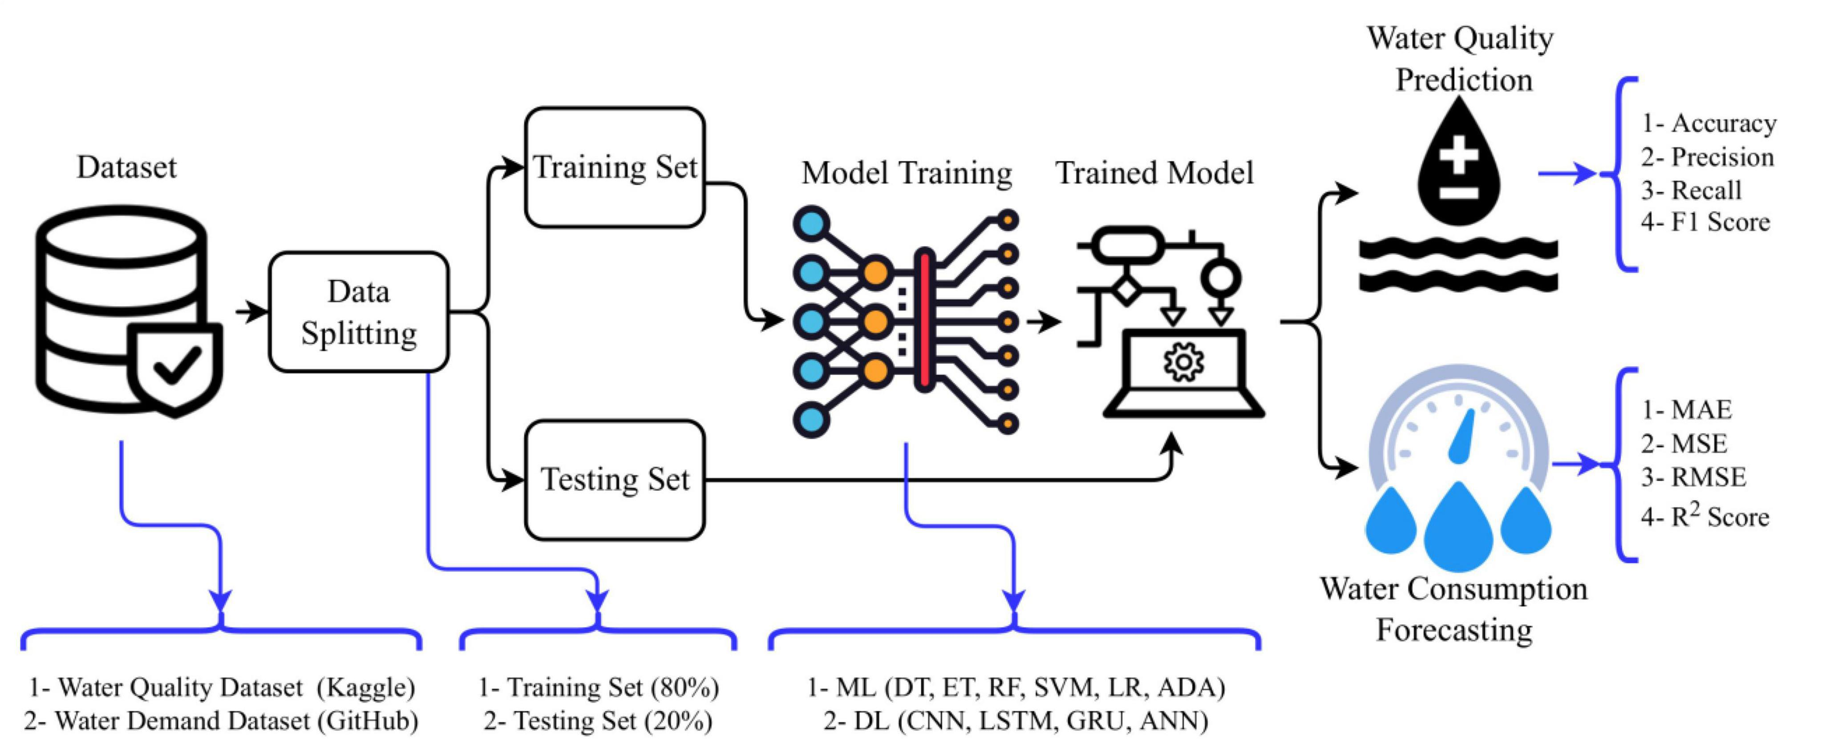
Abstract / Executive Summary
Developed an AI-powered system for water quality prediction and analysis.
Used Machine Learning algorithms to classify water as safe or unsafe.
Performed data preprocessing and Exploratory Data Analysis (EDA).
Implemented Logistic Regression, Decision Tree, Random Forest, XGBoost, and Neural Networks.
Random Forest achieved the best prediction performance among all models.
Stored prediction results in MySQL database
for analytical reporting.
Created an interactive Tableau dashboard for
visualization and insights.

Slide 6

Chapter 1: Introduction
Water pollution is a major environmental and public health issue worldwide.
Traditional water quality testing methods are time-consuming and manual.
Machine Learning helps automate water quality prediction efficiently.
The system analyzes parameters such as pH, turbidity, sulfate, and conductivity.
MySQL is used for structured data storage and management.
Tableau provides interactive visualization and analytical reporting.
The project integrates AI, DBMS, and Business Intelligence
technologies.

Slide 7
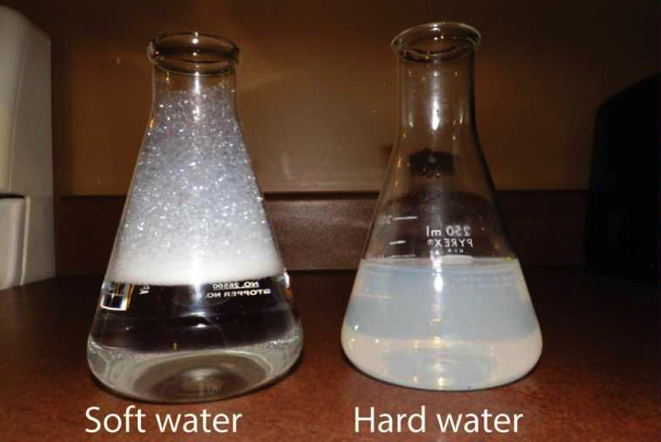
Chapter 2: System Study
Traditional water quality monitoring depends on manual laboratory testing.
Existing systems are time-consuming and less efficient for large-scale analysis.
Most conventional systems lack intelligent prediction capabilities.
Manual analysis increases operational cost and delays decision-making.
Existing systems provide limited visualization and analytical reporting.
Machine Learning enables automated prediction using historical water
quality data.
The proposed system improves prediction accuracy and analytical visualization.

Slide 8
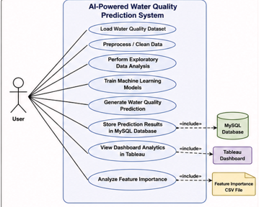
Chapter 3: System Analysis
The system accepts water quality datasets as input for analysis.
Data preprocessing handles missing and inconsistent values.
Multiple Machine Learning algorithms are trained and evaluated.
Random Forest was selected as the final prediction model.
Prediction results are stored in the MySQL database.
Tableau dashboard provides interactive visualization and reporting.
The system supports efficient monitoring of safe and unsafe water
conditions.

Slide 9
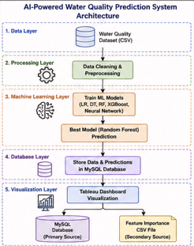
Chapter 4: System Design
The system follows a layered architecture integrating ML, MySQL, and Tableau.
Data preprocessing and feature preparation performed using Python libraries.
Multiple Machine Learning models trained for water quality prediction.
Random Forest selected as the final prediction model.
Processed records and prediction results stored in MySQL database.
Tableau connects with MySQL and Feature Importance CSV for visualization.
Interactive dashboards provide analytical reporting and pollution insights.

Slide 10
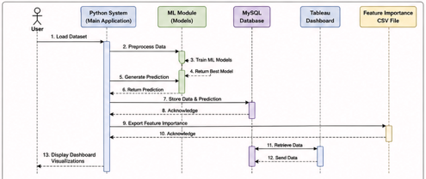
Chapter 5: System Implementation
Python used for data preprocessing and prediction generation.
Pandas and NumPy used for data cleaning and manipulation.
Multiple ML models including Random Forest and XGBoost were implemented.
Random Forest achieved the best prediction performance.
MySQL integrated for storing processed data and prediction results.
Tableau connected with MySQL and Feature
Importance CSV for analytics.
Joblib used for saving trained ML model and scaler.

Slide 11
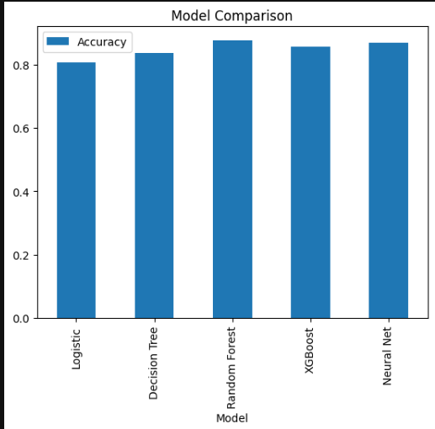
Chapter 6: Testing
Unit testing performed on preprocessing and ML modules.
Integration testing verified Python–MySQL–Tableau connectivity.
System testing validated complete workflow execution.
ML models evaluated using Accuracy, Precision, Recall, and F1-Score.
Database testing confirmed successful data insertion and retrieval.
Tableau dashboard testing verified filtering and visualization features.
All modules executed successfully after debugging and optimization.

Slide 12
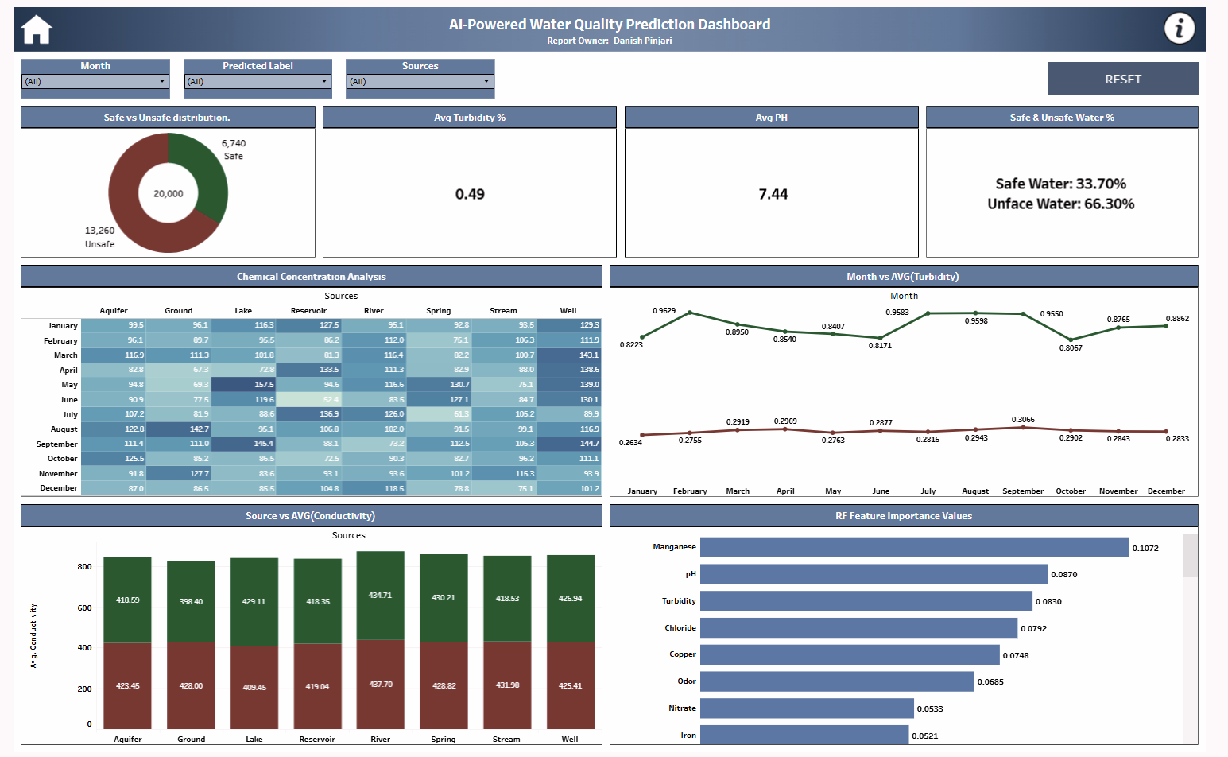
Chapter 7: Results & Discussion
Random Forest achieved the highest prediction performance.
The system successfully classified water samples as safe or unsafe.
Data preprocessing improved overall prediction quality.
MySQL database stored processed records and prediction outputs successfully.
Tableau dashboard provided interactive visualization and
analytical reporting.
Feature importance analysis identified major water quality
parameters.
The integrated system improved automation and decision-
making capability.

Slide 13
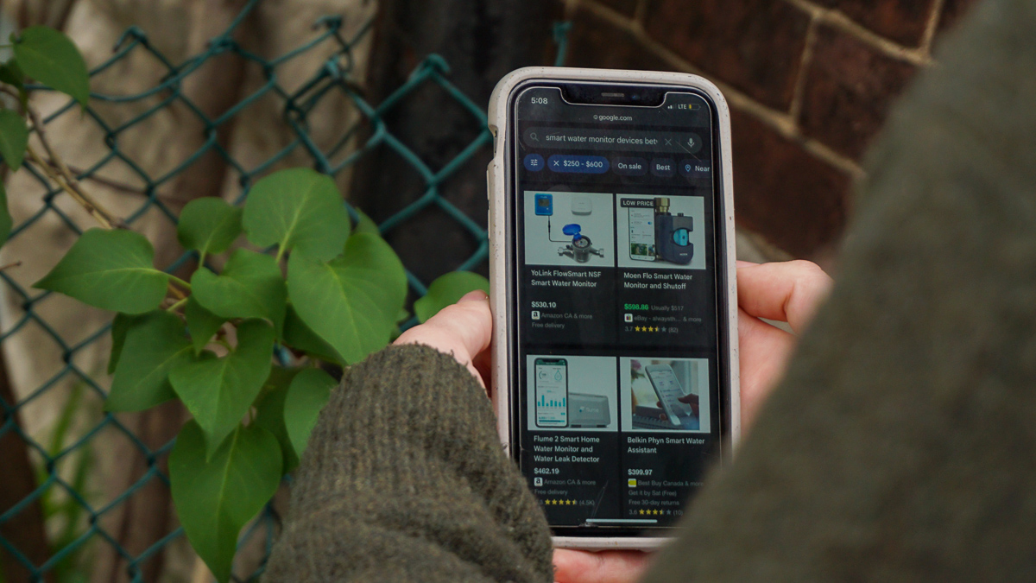
Chapter 8: Conclusion & Future Scope
Successfully integrated Machine Learning, MySQL, and Tableau technologies.
Random Forest achieved the best performance for water quality prediction.
The system automated prediction, database storage, and analytical reporting.
Tableau dashboard provided interactive insights into water quality conditions.
Feature importance analysis identified major parameters affecting water quality.
The project demonstrated practical application of AI in environmental
monitoring.
Future enhancements include IoT integration, cloud deployment, and GIS mapping.

Slide 14

Chapter 9: References
Scikit-learn Documentation
TensorFlow Documentation
XGBoost Documentation
MySQL Official Documentation
Tableau Official Website
Kaggle Water Quality Dataset
Research papers related to Machine Learning and Water Quality Prediction
This Photo by Unknown Author is licensed under CC BY-NC

Slide 15
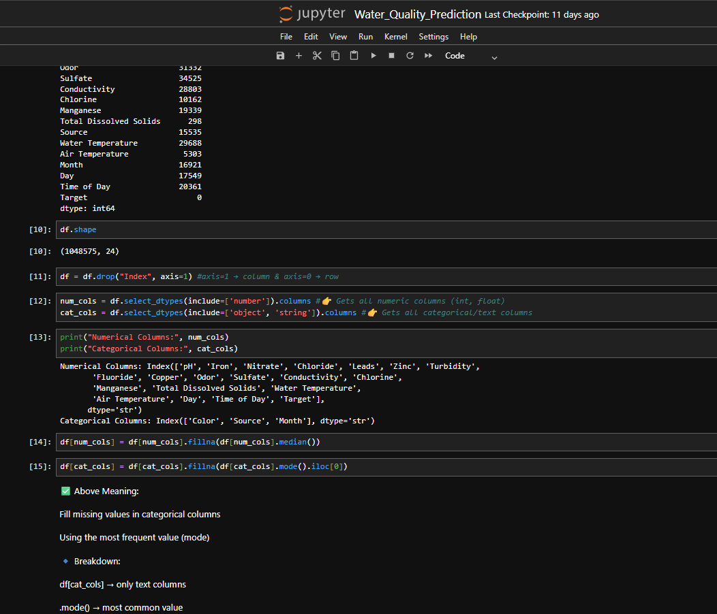
Chapter 10: Appendices
Source Code
Database Structure
MySQL Table & Prediction Records
Tableau Dashboard Screenshots
Machine Learning Output Screenshots
Feature Importance Analysis
User Manual & Workflow Documentation

Slide 16
Thank You

